Slide 1

Business Analysis & Strategy
A comprehensive overview of market challenges and strategic initiatives for Atlas Grands.
AJAY SUYAL
Intern

Slide 2





Atlas Grands
Atlas Grands is a well-established five-star hotel chain, embodying the essence of Indian Hospitality & Sustainability, with 20 years of experience in the hospitality industry.
25
Hotels
4
Destinations
2528 Keys
7 Distinct
Hotel Brands
3.62 +
review

Slide 3

Mission
Our Mission and Vision
Atlas Grands' mission is to leverage Business and Data Intelligence to regain their market share and revenue.
Due to strategic moves from other competitors and ineffective decision-making in management, Atlas Grands are losing its market share and revenue in the luxury/business hotels category.
Vision
The company's vision is to leverage data-driven insights to enhance decision-making, optimize business performance, and improve customer satisfaction

Slide 4






Goal # 1
Enhanced Customer Experience
Our Goals
Goal # 2
Atlas Grands has several strategic goals aimed at regaining its market share and improving business performance.
Operational Efficiency & Strengthening its position in the hospitality industry.
Goal # 3
Implementing analytics dashboards and key performance metrics to support strategic planning.

Slide 5
Comprehensive Data Overview
Dataset Period
The dataset spans from May 2022 to July 2022.
Cities Covered
Bookings are recorded from Bangalore, Delhi, Hyderabad, and Mumbai, highlighting regional diversity.
Data Files
Dimensional Tables
Dim Date: represents the dates present in May, June and July.
Dim Hotels: represents the name of each hotel and the Category (Luxury, Business)
Dim Rooms: represents the class of rooms [Standard, Elite, Premium, Presidential]
Fact Tables
Fact Aggregated Booking: (9200 rows)represents the Details of rooms And check in date or successful booking.
Fact Bookings: (1,34,590 rows)represents all details regarding booking , check in or check out, revenue, booking platform and room category.

Slide 6
Technology Stack Used
TOOL | Used For
Excel | Initial data loading & validation. Checking nulls & formatting issues.
SQL | Joining & filter tables. Aggregating dimension table.
Power BI | Creating dashboards.
Power Point | Presenting business context, problem & recommendation.

Slide 7
Data Audit & Cleaning
Data Audit
No duplicated values found, no special character found.
No null values and 0 amount in revenue
4 Location, 7 Property type, 2 Business Segment (Business, Luxury).
Total 25 Hotels, 4 types of room category (Standard, Elite, Premium, presidential).
Fact Bookings table 77,907 reviews are missing/ Not given.
Data from May to July, 92 Days
Cleaning
Replace the missing Value in review with 0

Slide 8
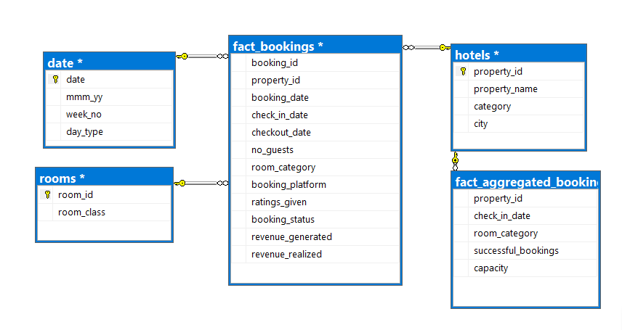
ER Diagram
Fact Bookings(room category) to Rooms(room id) [Mant to one]
Fact Bookings(Property id) to Hotels(Property id) [Mant to one]
Fact Bookings(Check in date) to date [Mant to one]
Fact aggregated Bookings (Property id) to Hotels(Property id) [Mant to one]

Slide 9
Metrics & Formulas
Metrics | Formula
Revenue | Revenue = SUM(revenue_realized)
Total Bookings | Total Bookings = COUNT(booking_id)
Total Capacity | Total Capacity = SUM(capacity)
Total Succesful Bookings | Total Successful Bookings = SUM(Fact aggregated bookings[successful bookings])
Occupancy % | Occupancy % = Total Succesful Bookings/Total Capacity
Average Rating | Average Rating = AVERAGE(ratings_given)
No of days | No of days = MAX(dim_date[date])-MIN(dim_date[date])
Total cancelled bookings | Total cancelled bookings = COUNT(booking_id),fact_bookings[booking_status]="Cancelled")
Cancellation % | Cancellation % =Total cancelled bookings/Total Bookings
Total Checked Out | Total Checked Out = COUNT(booking_id),fact_bookings[booking_status]="Checked Out")
Realization % | Realization % = Total Checked Out/Total Bookings
ADR | ADR = Revenue/Total Bookings
RevPAR | RevPAR =Revenue/Total Capacity
DBRN | DBRN = Total Bookings/No of days
DSRN | DSRN = Total Capacity/No of days
DURN | DURN = Total Checked Out/No of days

Slide 10
Booking Dashboard Layout
Booking Dashboard
Navigation
Home
filters
Total Booking
Total Capacity
Occupancy
Total Room
weekday
1.Investors & owners
2. Hotel Management
Month
Pie chart by category
Booking BY platform
City
Occupancy by room class

Slide 11
Hospitality Industry Analysis Overview
Booking Analysis
Analysis
Booking percentage by booking channel.
Booking of the hotel category.
Booking effect on Weekday and Weekend.
Total occupancy & Booking trend.
Impact Of Analysis
Improves booking efficiency.
Identifies the most effective booking channels.
Understand Customer behavior.
Improves customer acquisition and retention strategies.

Slide 12
Revenue Dashboard Layout
Home
Revenue Dashboard
Navigation
filters
Total Revenue
Total Capacity
Occupancy
Total Room
weekday
Month
Pie chart revenue by category
1.Hotel Management & Executives
2. Investors & owners
Bar chart revenue BY platform
property
bar chart avg. revenue by city
Line chart BY day

Slide 13
Hospitality Industry Analysis Overview
Revenue Analysis
Analysis
Revenue contribution by booking channel.
Revenue by hotel category & city.
Booking effect on Weekday and Weekend.
Total revenue & Expected revenue.
Impact Of Analysis
Improves revenue leakage.
Identifies the most effective channels.
Assesses revenue and occupancy by location.

Slide 14
Cancellation Dashboard Layout
Home
Cancellation Dashboard
Navigation
filters
Total Cancelled Booking
Cancellation %
Total Check Out
Realization
weekday
Month
Column chart revenue and change by month
Line chart for property
1.Investors & owners
2. Industry Association
City
Line chart by room
Bar chart review of property

Slide 15
Hospitality Industry Analysis Overview
Cancellation Analysis
Analysis
Total Cancelled bookings.
Cancelled booking by hotel category & city.
Realization percentage and.
Total successfully checkout.
Impact Of Analysis
understand the cancellations adjust policies, pricing.
Customer engagement strategies to minimize revenue loss
Identifies the most effective city .
Improve Occupancy rate.

Slide 16
Dashboard Layout
Impact Of Analysis
Home
Month & week Dashboard
Navigation
filters
Re-PAR on monthly column chart
Weekly Booking demand by line chart
day
1.Management & sales team
2. Hospitality consultants
Room class
Month booking trend line chart
Weekly Cancellation trend by line chart
City

Slide 17
Impact of Analysis
1. Month & Weekly trend Analysis
Analysis
Week on week Total revenue and change.
Week on week Occupancy shift.
Month on Month revenue and change.
Total successfully checkout.
Impact Of Analysis
Marketing effort and price adjustment.
Identifies peak and off-peak demand patterns.
Adjusts pricing dynamically to maximize revenue.

Slide 18
Impact of Analysis on Business Growth
Stake Holder In The Hospitality Industry Analysis
Investors & owners –
Provide financial backing and Business performance.
Industry Association –
Facilitate networking and Knowledge sharing.
Hotel Management & Executives –
To take decision.
Marketing & Sales team –
To refine promotional strategies.
Hospitality Consultants –
To provide insights and recommendations.
Strategic Decision-Making –
Helps management optimize pricing, service offerings, and marketing strategies.
Revenue Optimization –
Allows dynamic pricing adjustments and better resource allocation.
Enhanced Customer Experience –
Personalizes services to align with guest preferences.
Improves customer acquisition and retention strategies.
Operational Efficiency –
cost control, facility management.
Competitive Advantage –
Enables benchmarking against competitors to refine market positioning.

Slide 19


Microsoft Power BI

Slide 20

Relaunch the add-in
Microsoft Power BI
After you install the add-in, you can launch it by choosing the add-in button on the Insert tab
On the Insert tab
Insert
My Add-ins
Need more help?
Return to your internet browser or copy this link into your browser:
https://pages.store.office.com/addinsinstallpage.aspx?rs=en-US&assetid=WA200003233&isWac=True&ui=en-US&ad=US

Slide 21
Booking & Occupancy Analysis
Insights:
The overall hotel occupancy rate is 57.87%, with May seeing a peak of 58.55% over the last three months.
Luxury category Hotel are (62.16%) of total bookings making them the major revenue drive.
Occupancy increases to 73.58% on weekends, highlighting strong demand during leisure periods
Over 40% of bookings come from third-party platforms, potentially reducing profitability .
Recommendation:
Enhance visibility and marketing for properties like Atliq Seasons to improve occupancy.
Offer targeted weekday promotions and loyalty benefits to boost demand.
Shift more bookings to direct hotel platforms to increase margin and reduce dependency on third parties.
Implement weekend-exclusive offers to push occupancy beyond the current 75% threshold.

Slide 22
Revenue Analysis
Insights:
The total revenue stands at ₹1.71 billion, indicating strong performance but room for optimization
Luxury hotels contribute 61.61% of total revenue, showcasing their importance
The Average Daily Rate (ADR) in Mumbai is higher than other cities, signaling premium pricing potential.
The revenue per room remains low in certain categories despite steady ADR levels.
Recommendations:
Adjust pricing to optimize revenue across different locations.
Focus on hotel-owned platforms to increase direct revenue contributions.
Increasing Luxury category pricing could further enhance revenue.

Slide 23
Cancellation & No show Analysis
Insights:
A total of 33.42K bookings (24.83%) were canceled, impacting revenue by 14.88%.
5.02% of bookings resulted in guests not showing up.
Cancellations were highest on weekdays (25%+) for the Luxury category.
In June, cancellations exceeded 25.5%, likely due to weather concerns.
Recommendations:
Simplify reservations and provide clear confirmation processes to reduce cancellations.
Introduce adjustable policies to retain bookings.
Adopt controlled overbooking to mitigate losses from last-minute cancellations.
Strengthening pre-arrival communication and offering incentives can build trust and reduce last-minute cancellations.

Slide 24
Month & Week Trend Analysis
Insights:
Booking volume fluctuates, following a zig-zag pattern on a weekly basis.
Revenue Drop in June: Revenue declined by 4.81%, possibly due to seasonal factors.
Week-by-week booking trends significantly impact occupancy.
Recommendations:
Implement discounted long-stay packages or seasonal promotions to counter June revenue decline.
Address fluctuations through strategic campaign launches tied to peak periods.
Use dynamic pricing to balance demand across low and high seasons.
Introduce monsoon-special packages and collaborate with nearby attractions to create experience-based promotions.

Slide 25
Final Strategic Focus
Shift towards high-margin direct bookings rather than third-party reliance.
Drive weekday engagement through specialized business packages.
Reduce cancellation impact via flexible policy adjustments.
Elevate digital presence with AI personalization and smart automation.
Expand revenue streams beyond room rates through experiential tourism.

Slide 26


